Slide 1

Programming with Python
Chapter 8

Slide 2
Getting Inside Objects and Classes
What is the definition of object?
What is the definition of class?
Programmers who use objects and classes (such as Java programmers) know:
Interface that can be used with a class
State of an object
How to instantiate a class to obtain an object
Objects are abstractions
Package their state and methods in a single entity that can be referenced with a name
Class definition is like a blueprint for each of the objects of that class

Slide 3
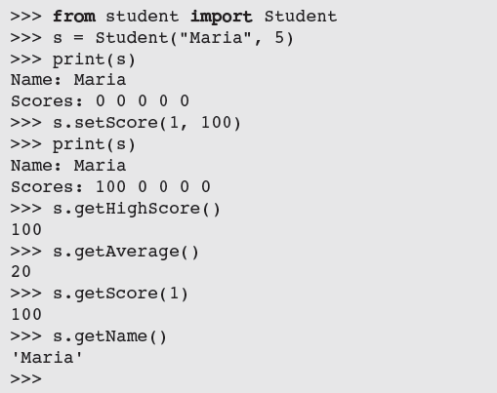
A First Example: The Student Class
A course-management application needs to represent information about students in a course
Read this program output. What are the characteristics of the Student object?

Slide 4
The Student Class

Slide 5
The Student Class
Syntax of a simple class definition:
Class name is a Python identifier
Typically capitalized
Python classes are organized in a tree-like class hierarchy
At the top, or root, of this tree is the object class
Some terminology: subclass, parent class
← class header

Slide 6
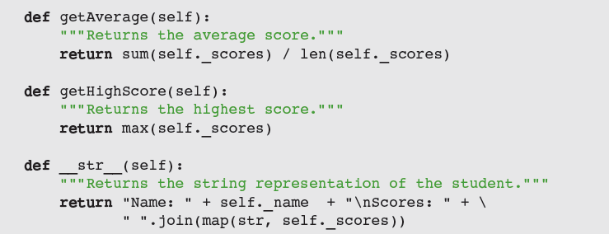
The Student Class

Slide 7
Docstrings
Docstrings can appear at three levels:
Module
Just after class header
To describe its purpose
After each method header
Serve same role as they do for function definitions
help(Student) prints the documentation for the class and all of its methods

Slide 8
Method Definitions
Method definitions are indented below class header
Syntax of method definitions similar to functions
Can have required and/or default arguments, return values, create/use temporary variables
Returns None when no return statement is used
Each method definition must include a first parameter named self
Example: s.getScore(4)
Binds the parameter self in the method getScore to the Student object referenced by the variable s

Slide 9
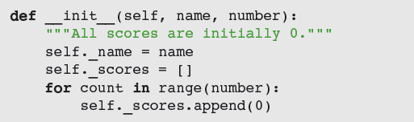
The __init__ Method and Instance Variables
Most classes include the __init__ method
Class’s constructor
Runs automatically when user instantiates the class
Example: s = Student("Juan", 5)
Instance variables represent object attributes
Serve as storage for object state
Scope is the entire class definition

Slide 10
The __str__ Method
Classes usually include an __str__ method
Builds and returns a string representation of an object’s state
When str function is called with an object, that object’s __str__ method is automatically invoked
Perhaps the most important use of __str__ is in debugging

Slide 11
Accessors and Mutators
Methods that allow a user to observe but not change the state of an object are called accessors
Methods that allow a user to modify an object’s state are called mutators
Tip: if there’s no need to modify an attribute (e.g., a student’s name), do not include a method to do that

Slide 12
The Lifetime of Objects
The lifetime of an object’s instance variables is the lifetime of that object
An object becomes a candidate for the garbage collection when it can no longer be referenced
Student object still exists, but interpreter will recycle its storage during garbage collection

Slide 13
Rules of Thumb for Defining a Simple Class
Before writing a line of code, think about the behavior and attributes of the objects of new class
Choose an appropriate class name and develop a short list of the methods available to users
Write a short script that appears to use the new class in an appropriate way
Choose appropriate data structures for attributes
Fill in class template with __init__ and __str__
Complete and test remaining methods incrementally
Document your code

Slide 14
Case Study: Playing the Game of Craps
Request:
Write a program that allows the user to play and study the game of craps
Analysis: define Player and Die classes
User interface: prompt for number of games to play

Slide 15
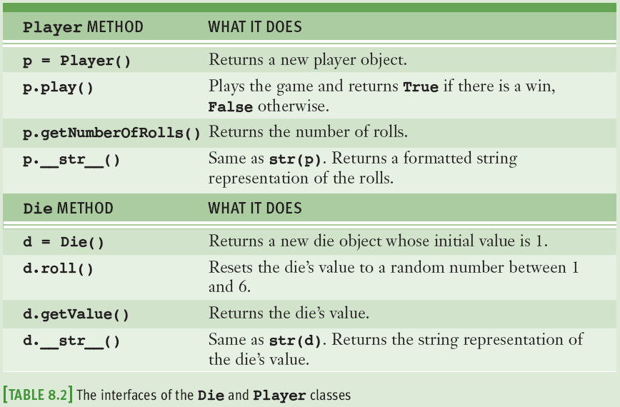
Case Study: Design

Slide 16
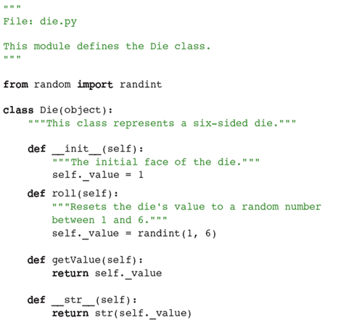
Case Study: Implementation

Slide 17
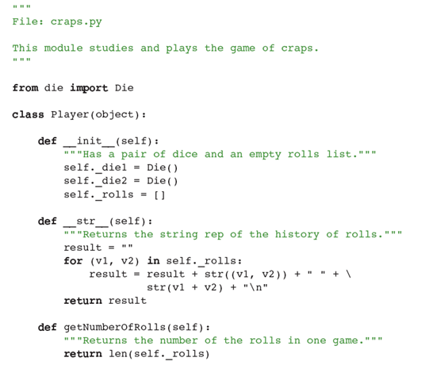
Case Study: Implementation

Slide 18
Object-Modeling Examples
As you have seen, objects and classes are useful for modeling objects in the real world
In this section, we explore several other examples

Slide 19
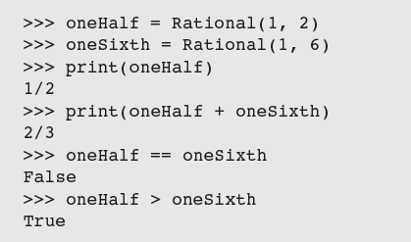
Rational Numbers
Rational number consists of two integer parts, a numerator and a denominator
Examples: 1/2, 2/3, etc.
Python has no built-in type for rational numbers
We will build a new class named Rational
Operators need to be overloaded

Slide 20
Rational Number Arithmetic and Operator Overloading
Object on which the method is called corresponds to the left operand
For example, the code x + y is actually shorthand for the code x.__add__(y)

Slide 21
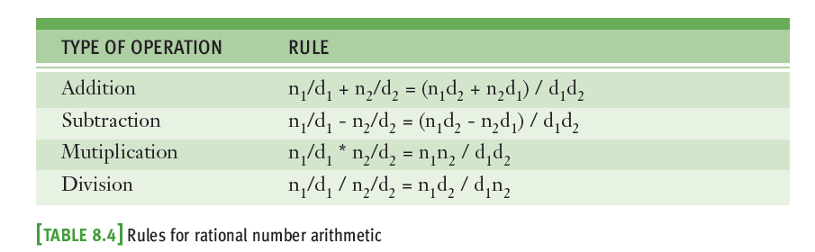
Rational Number Arithmetic and Operator Overloading
To overload an arithmetic operator, you define a new method using the appropriate method name
Code for each method applies a rule of rational number arithmetic

Slide 22
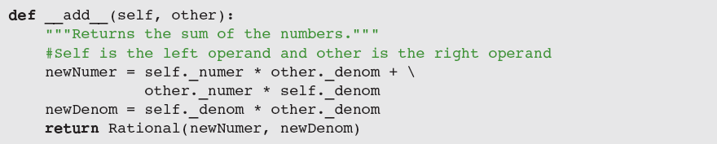
Rational Number Arithmetic and Operator Overloading
Operator overloading is another example of an abstraction mechanism
We can use operators with single, standard meanings even though the underlying operations vary from data type to data type

Slide 23
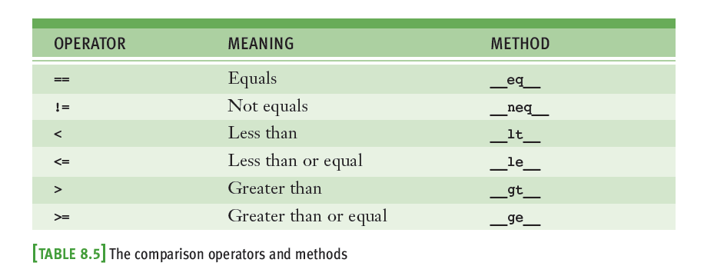
Comparison Methods

Slide 24
Equality and the __eq__ Method
Not all objects are comparable using < or >, but any two objects can be compared for == or !=
twoThirds < "hi there" should generate an error
twoThirds != "hi there" should return True
Include __eq__ in any class where a comparison for equality uses a criterion other than object identity

Slide 25
Savings Accounts and Class Variables

Slide 26
Savings Accounts and Class Variables

Slide 27
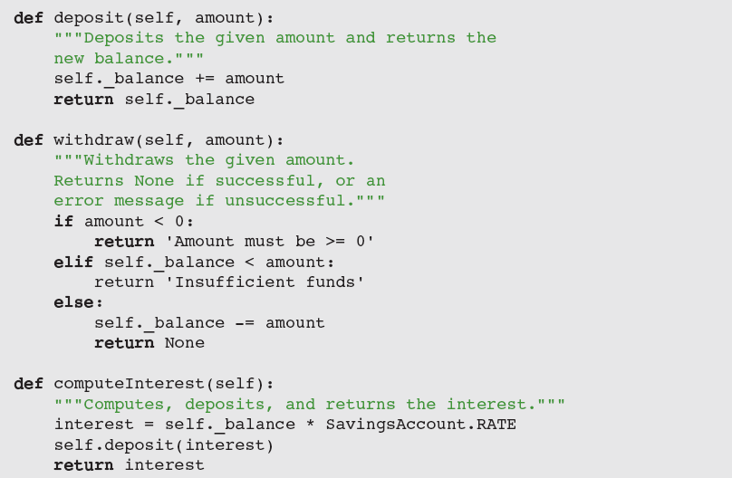
Savings Accounts and Class Variables

Slide 28
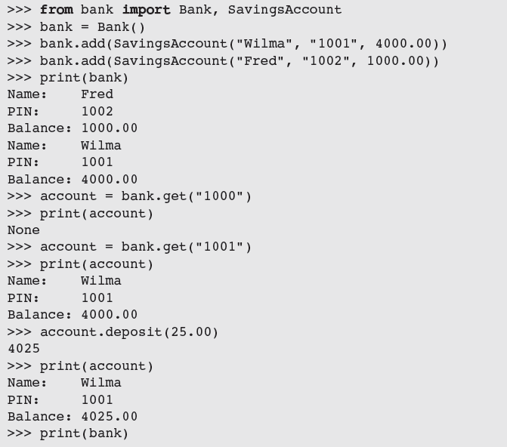
Putting the Accounts into a Bank

Slide 29
Putting the Accounts into a Bank

Slide 30
Putting the Accounts into a Bank

Slide 31
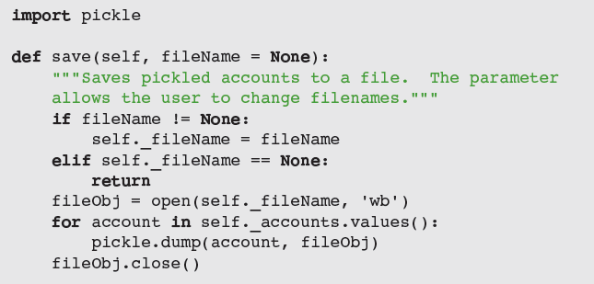
Using pickle for Permanent Storage of Objects
pickle allows programmer to save and load objects using a process called pickling
Python takes care of all of the conversion details

Slide 32
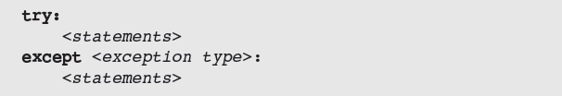
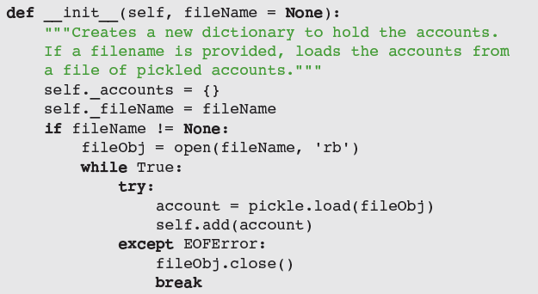
Input of Objects and the try-except Statement

Slide 33
Case Study: An ATM
Develop a simple ATM program that uses the Bank and SavingsAccount classes
Request:
Write a program that simulates a simple ATM
Analysis:
Class diagram in Figure 8.2 shows the relationships among the classes
Name of each class appears in a box
Edges connecting the boxes show the relationships
Use model/view pattern to structure the code

Slide 34
Case Study: An ATM

Slide 35
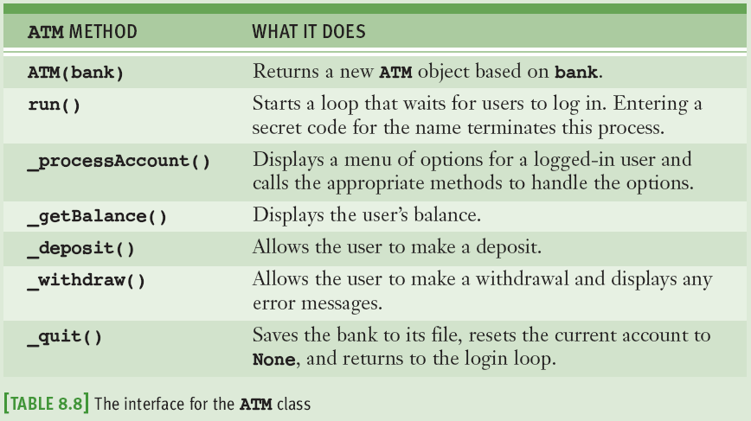
Case Study: ATM Design

Slide 36
Structuring Classes with Inheritance and Polymorphism
Most object-oriented languages require the programmer to master the following techniques:
Data encapsulation: Restricting manipulation of an object’s state by external users to a set of method calls
Inheritance: Allowing a class to automatically reuse/ and extend code of similar but more general classes
Polymorphism: Allowing several different classes to use the same general method names
Python’s syntax doesn’t enforce data encapsulation
Inheritance and polymorphism are built into Python

Slide 37
Inheritance Hierarchies and Modeling

Slide 38
Inheritance Hierarchies and Modeling
In Python, all classes automatically extend the built-in object class
It is possible to extend any existing class:
Example:
PhysicalObject would extend object
LivingThing would extend PhysicalObject
Inheritance hierarchies provide an abstraction mechanism that allows the programmer to avoid reinventing the wheel or writing redundant code

Slide 39
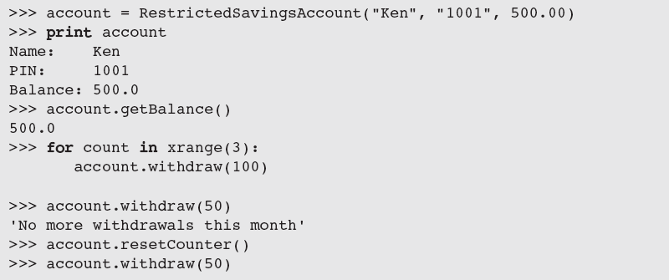
Example: A Restricted Savings Account
A RestrictedSavingsAccount permits up to three withdrawals
To call a method in the parent class from within a method with the same name in a subclass:

Slide 40
Polymorphic Methods
We subclass when two classes share a substantial amount of abstract behavior
The classes have similar sets of methods/operations
A subclass usually adds something extra
The two classes may have the same interface
One or more methods in subclass override the definitions of the same methods in the superclass to provide specialized versions of the abstract behavior
Polymorphic methods (e.g., the __str__ method)

Slide 41
Abstract Classes
An abstract class includes data and methods common to its subclasses, but is never instantiated

Slide 42
The Costs and Benefits of Object-Oriented Programming
Imperative programming
Code consists of I/O, assignment, and control (selection/iteration) statements
Does not scale well
Improvement: Embedding sequences of imperative code in function definitions or subprograms
Procedural programming
Functional programming views a program as a set of cooperating functions
No assignment statements
Functional programming does not conveniently model situations where data must change state
Object-oriented programming attempts to control the complexity of a program while still modeling data that change their state
Divides up data into units called objects
Well-designed objects decrease likelihood that system will break when changes are made within a component
Can be overused and abused

Slide 43
Summary
A simple class definition consists of a header and a set of method definitions
In addition to methods, a class can also include instance variables
Constructor or __init__ method is called when a class is instantiated
A method contains a header and a body
An instance variable is introduced and referenced like any other variable, but is always prefixed with self

Slide 44
Summary
Some standard operators can be overloaded for use with new classes of objects
When a program can no longer reference an object, it is considered dead and its storage is recycled by the garbage collector
A class variable is a name for a value that all instances of a class share in common
Pickling is the process of converting an object to a form that can be saved to permanent file storage
try-except statement is used to catch and handle exceptions

Slide 45
Summary
Most important features of OO programming: encapsulation, inheritance, and polymorphism
Encapsulation restricts access to an object’s data to users of the methods of its class
Inheritance allows one class to pick up the attributes and behavior of another class for free
Polymorphism allows methods in several different classes to have the same headers
A data model is a set of classes that are responsible for managing the data of a program

